Slide 1
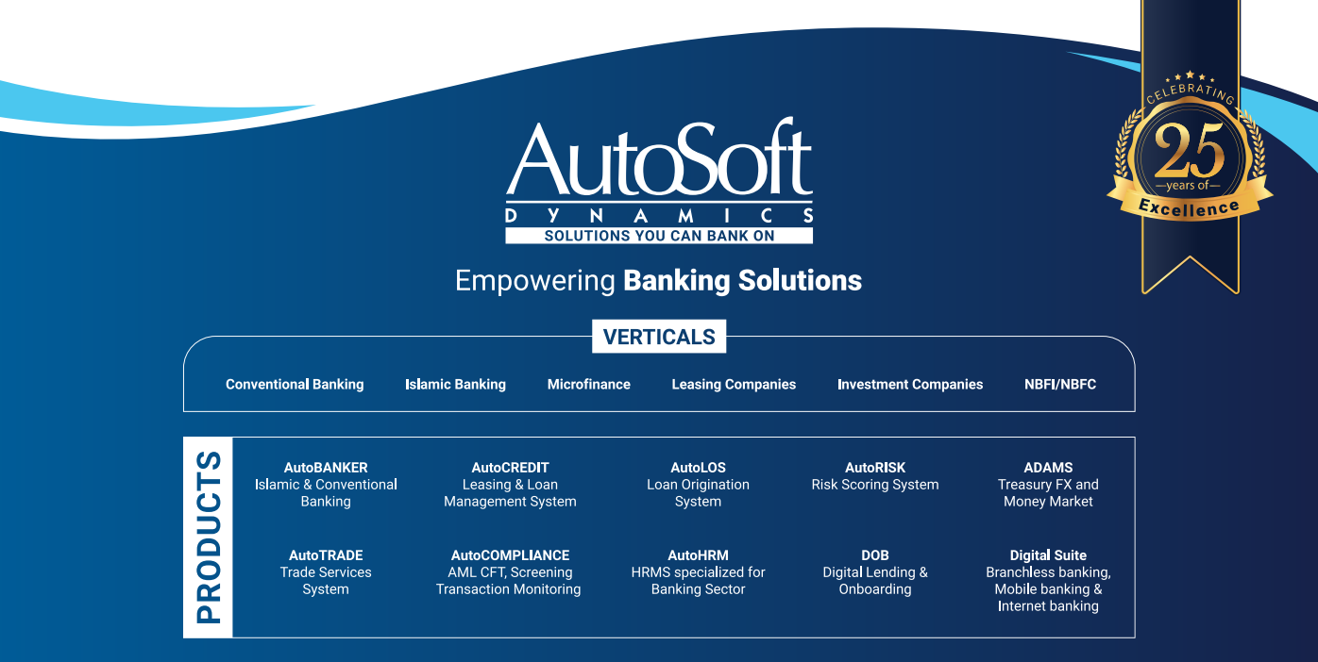
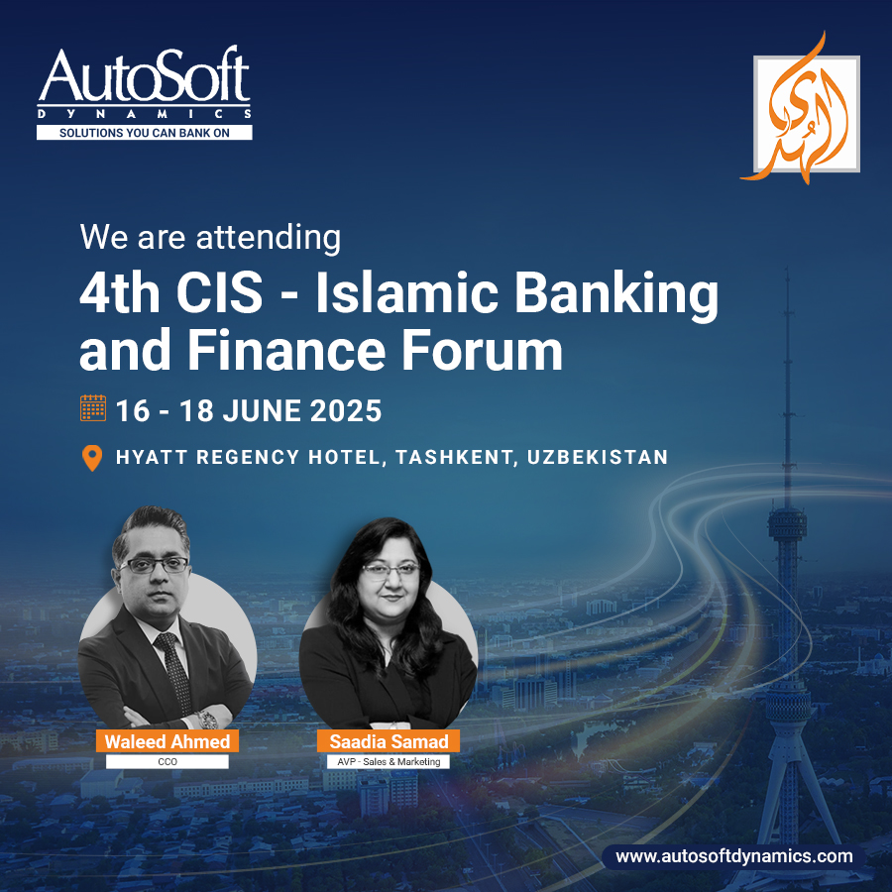

Company Introduction
&
Product Overview

Slide 2

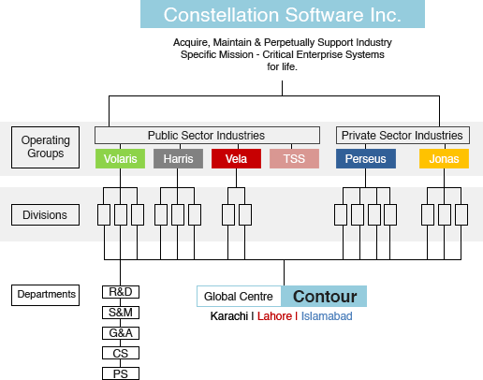
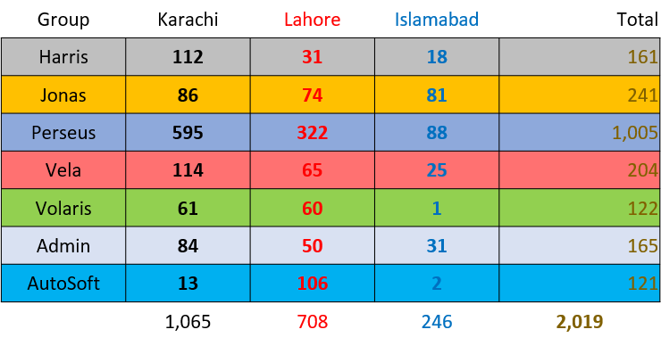


www.csisoftware.com
www.contour-software.com
Global Conglomerate of Industry-Specific Enterprise Software brands
Wholly-Owned Dedicated Global Centre for Constellation.
  Started with a dozen people; crossed 2000 core staff in 15 Years.
  Platinum Export Growth Award Winner.
  Supporting All Departmental Functions at Divisional & Corporate Level.
Became a Portfolio company for CSI Perseus in 2022, with 1st acquisition [AutoSoft Dynamics] in Pakistan.
Led the 1st Industry-Driven Tech Bootcamp for Grads - TechLift
Founded: 1995
Employees: 46,000+
Industries: 100+
Countries: 100+
Product Suites/Business Units: 1000+
Global Revenues: US$6+ Billion
Market Cap: $40+ Billion
Status: Publicly Listed {CSU.TO (Canada)}
Largest Canadian Software Company
by revenues & market cap (TSX: CSU.TO).
Top performer on the S&P/TSX
over 8 years – Bloomberg, July 25, 2018.
Top Strategic/Volume Acquirer of Software Companies globally (2017-2018-2019) - Corum Group.

Slide 3
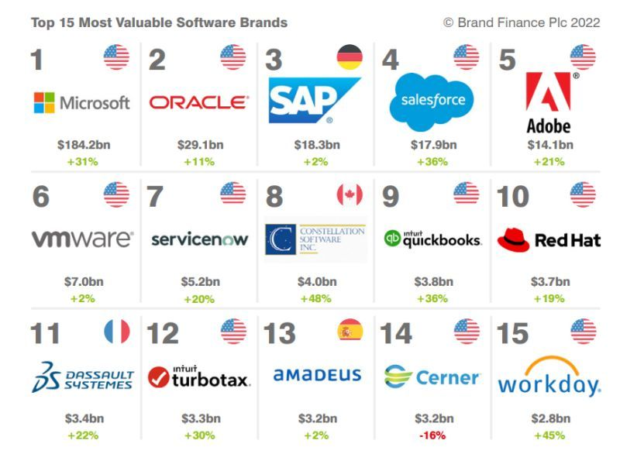



Our Corporate Nexus
Top 15 Software Companies Globally
Constellation Software Inc. is ranked #8 of the top 15 most valuable brands globally, as identified by Brand Finance.in 2022
Fastest-growing brand in the ranking, with its brand value increasing by 48% year on year
Revenues in excess of US$10B, is the fastest growing amongst the Top 10 Software companies of the world
Network of 1200+ companies across more than 150 countries with 50,000+ workforce
One of the Top 5 IT Exporters of Pakistan
2500+ local support staff available in Pakistan
Pakistan's premier financial solutions provider,
Product maturity of 25+ years, backed by 50+ years of industry experience
Pioneering 100% Shariah compliant solutions for over two decades
Complete Shariah-compliant digital suite, covering onboarding, lending, loan management and more.

Slide 4












Our Core Attributes
  AutoSoft – Pakistan based financial solution provider
  “Solutions You Can Bank On”
Constellation & Contour’s first acquisition in Pakistan
AutoSoft: 150+ Employees
46K+ in overall Group
CSI Perseus Boson Company
Offices in 3 Major Cities
50 Years
Banking industry expertise
and domain knowledge
25Years
Experience in transforming
banking operations across the globe
20 Years
Serving Islamic
banking Industry
3-4 months
Fastest implementation track record for more than 2 decades
8+ Clients in Middle East / Africa
Empowered by unmatched
core banking solutions
19+ Clients in Pakistan
Benefiting from end-to-end banking services and digital channels
5+ Clients MFI
Fueling microfinance
landscape
4+ Islamic Banking
Institutions using 100% Shariah
compliant products
5M+ Customers
Handled via
Core Banking System
Pakistan’s 25% MM Transactions
Handled via
Treasury Management System
Highly Scalable
No proprietary HW/SW required
leading to cost effective solution
Pakistan based Company
Having internationally
competing products

Slide 5




Global Clientele Network
Afghanistan
Pakistan
South Sudan
Bahrain
Burundi
Zambia
Pakistan
Zambia
Afghanistan
South Sudan
Bahrain
Burundi
20 Customers
01 Customer
02 Customers
01 Customer
01 Customer
06 Customers
Notes:
AutoSoft has customers within the Middle East, Asia and Africa.
In Pakistan AutoSoft is playing a vital role to create financial inclusion with its solutions and holds 34% of the market comprising of not just small but also larger financial institutions
45 Sec

Slide 6
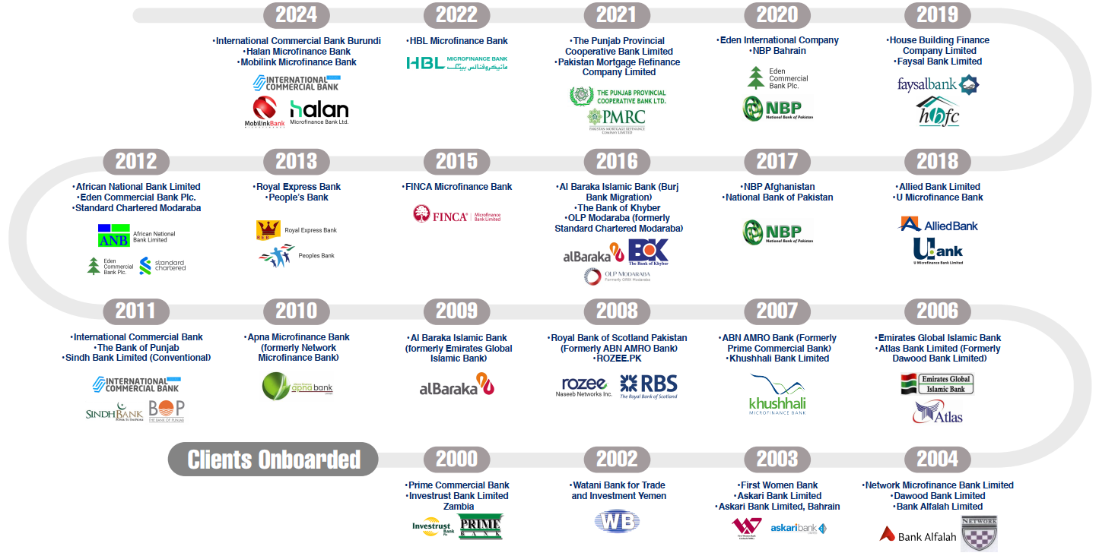
Clients Timeline

Slide 7
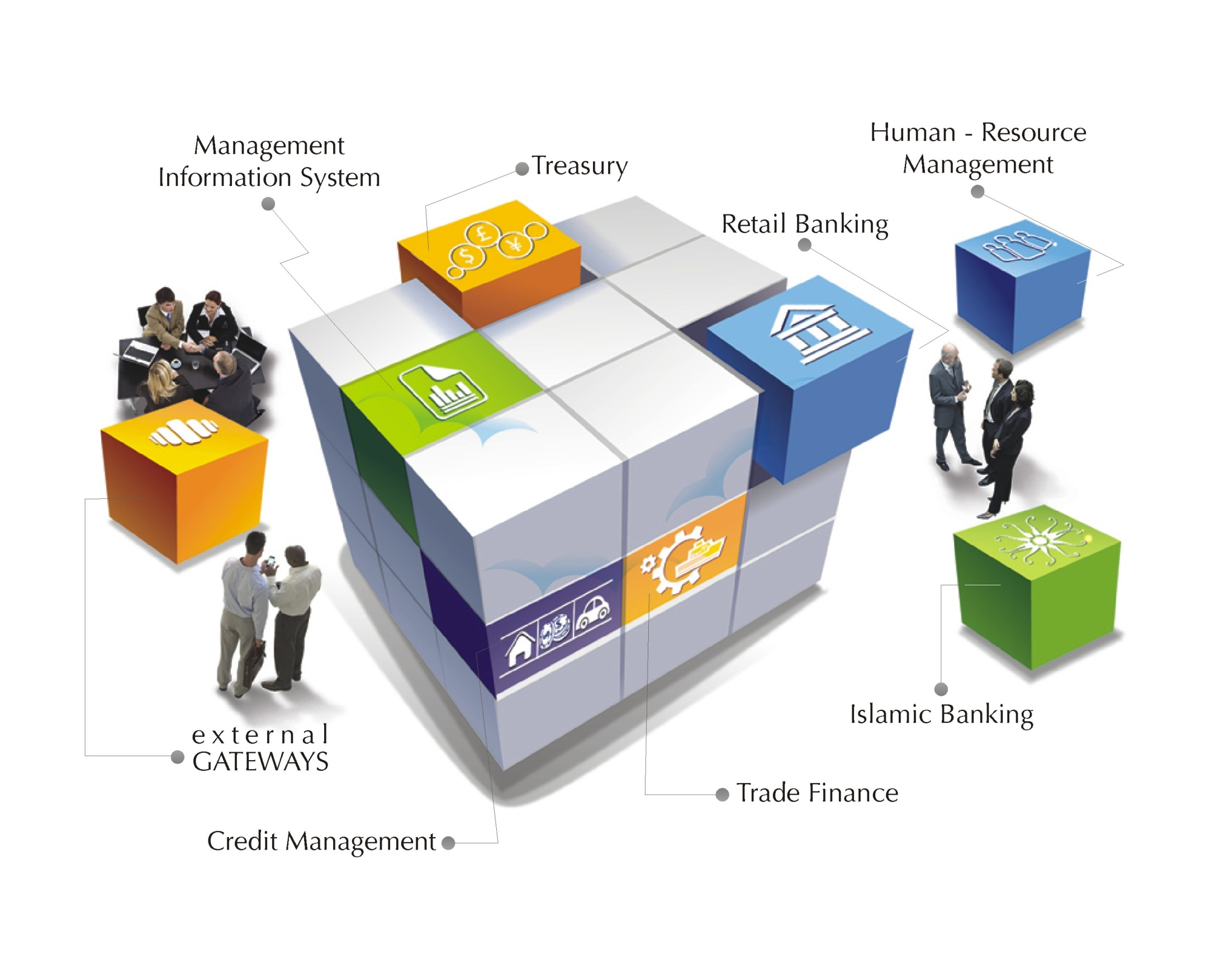

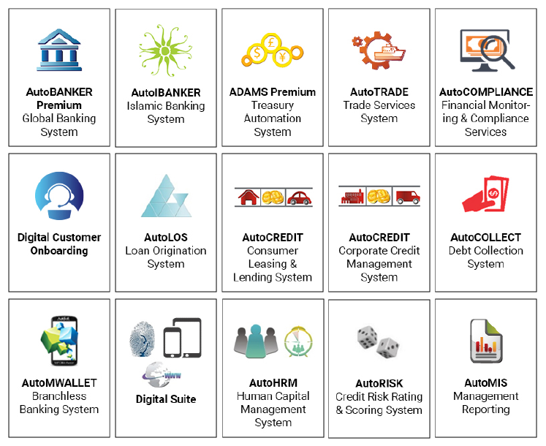
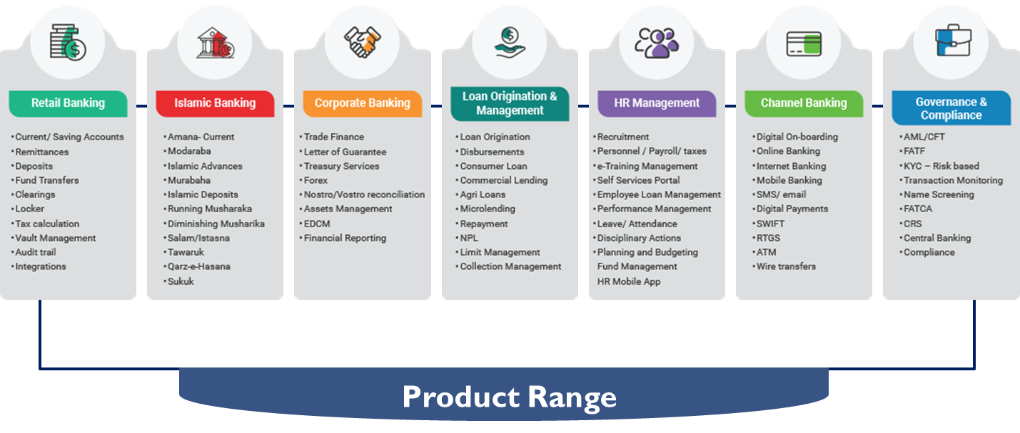
End to End Banking Solution
Diversified
seamlessly integrated products
One Stop Shop
Plug n play configurable Modules
AutoSoft Skills Set – 1000+ Man Years of Experience
Comprehensive Offerings

Slide 8
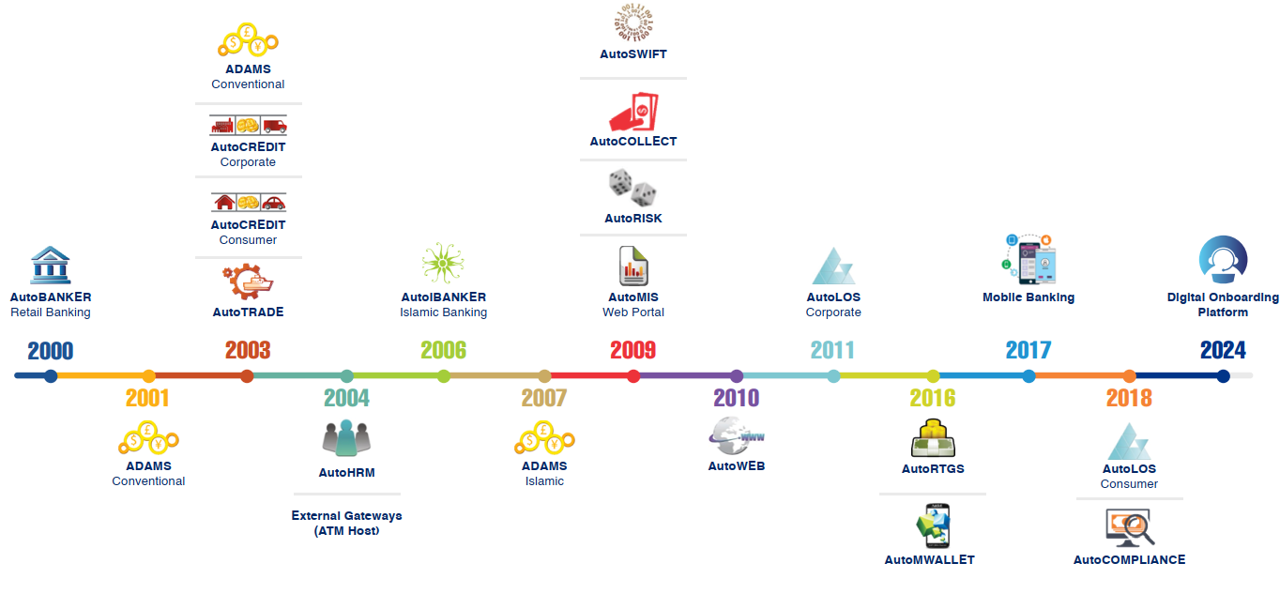
Product Launch Timeline

Slide 9
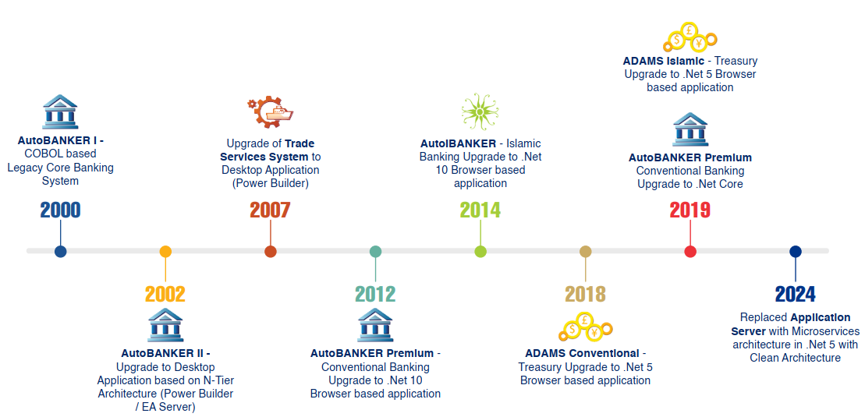
Upgrades Timeline

Slide 10
Islamic Banking Journey
2006
Launch of
AutoIBANKER
2007
Emirates Global Islamic Bank
(First taker of Islamic banking system
2011
Al Baraka Islamic Bank
(Oldest Islamic Bank in Pakistan)
2012
Sindh Bank Limited
2020 -2023
OLP (Standard Chartered Modaraba)
2014
Faysal Bank Complete conversion to Islamic advances portfolio
Largest conversion of credit card to commodity based Modaraba
2017
Complete migration of Burj Bank

Slide 11
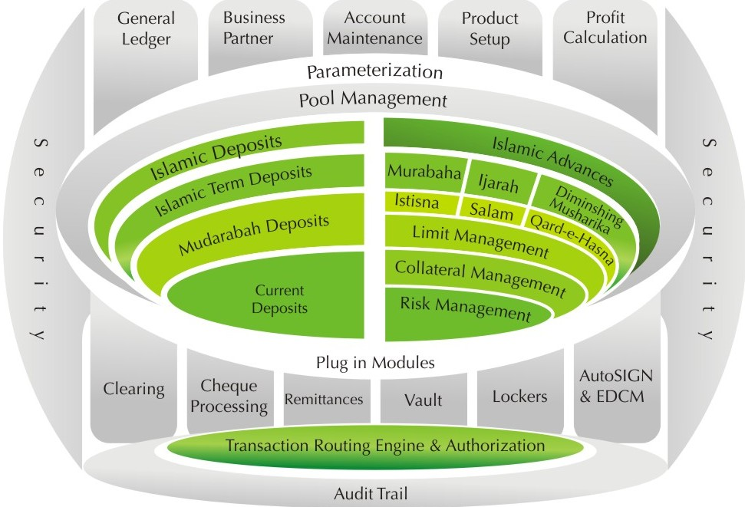
AutoIBANKER – Islamic Core Banking System
AutoIBANKER Islamic Core Banking System: Shariah-compliant Islamic banking system which caters for the requirements of Islamic banking via its customizable parameter setup, enabling banks to offer a competitive range of Islamic financial products providing online and real time synchronized banking business automation.
  Account Management
    Savings
    Current
  Business Partner / Customer Management
  Instrument / Stock Management
  Cheque Management
  Transactions
  Transaction workflow engine
  Clearing
  Islamic Term Deposit
  Vault management system
  AutoTELLER & AutoSIGN
  AutoREMIT
  AutoLOCKER
  AutoBIOMETRIC
  ATM
  Cash Management
  EDCM (Electronic Document Management System)
  Audit Trail

Slide 12

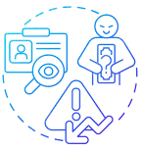
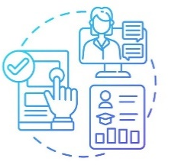
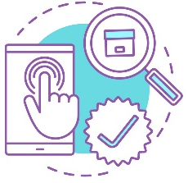

Complete Lending Lifecycle
Fully integrated lifecycle (onboarding till closure)
DIGITAL ONBOARDING
LOAN ORIGINATION
LOAN MANAGEMENT
COLLECTION
Initiation Process
Credit Application (Loan Application Form)
Support for both Islamic & Conventional Products including Credit Card
Sales Hierarchy Structure
Rule based Credit Policy & Segment-Wise Capping
Discrepancies, Deviations, Deferrals, Rejections
Asset & Collateral Management
Appraisals & Legal opinion
Income Estimations & DBR
Integrations ECIB / Data Check / Compliance / Call Center /A Score/NADRA/OCTR/Title Fetch)
Documentation checklist
Mult Level Verifications
(Interdepartmental & External Vendors)
Configurable Workflows and Queues
Escalation Matrix
Approval/ Decisioning Hierarchies based on Limit
Delegation & Deviation Matrices
Recovery Team Setup
Case assignment to staff
Record Collection Call details & promises
Notices and reminders
Follow ups
Litigation details by proposal
Dispute resolution
Collateral / Asset Management
Credit Administration (CAD) Processing (Purchase Order, Delivery Acceptance, Advance Booking)
Account opening
Transaction Initiation & Authorization
Stationery printing
Disbursements
Restructuring / Repricing
Provision for partial & full recoveries
Classification based criteria
    Regular conduct
    Suspense mark-up booking
    No accrual
    Write off
Flexible accounting treatment
Booking / suspension of income
Self
Agent
Consumer
Corporate
Islamic Advances
Microfinance
Mortgage
Leasing

Slide 13
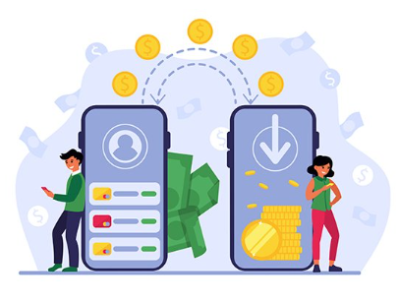
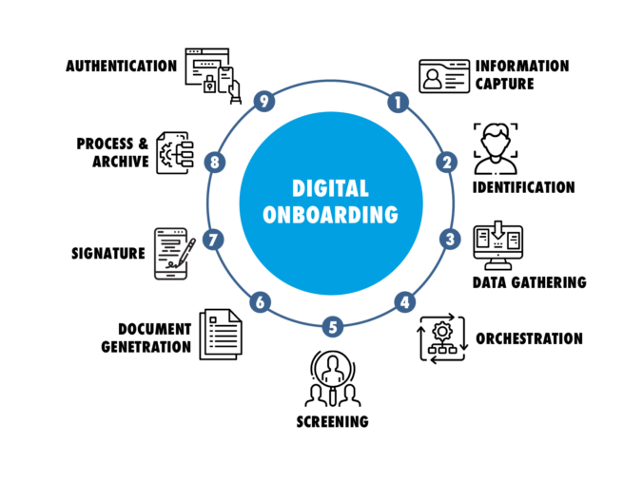
Digital onboarding
DOB (Retail plus lending)
Seamlessly Integrated with Loan Origination System
LOS
  Self-Registration
  Configurable workflows and interface
  Selfie and liveliness check
  Configurable workflow
  Contactless Biometric Verification
  Digital Signatures
  Electronic Document Attachment
  Realtime screening
  SBP security guidelines
  Platform Independent
  Can run mobile/ tab / browser
  Terms and conditions

Slide 14
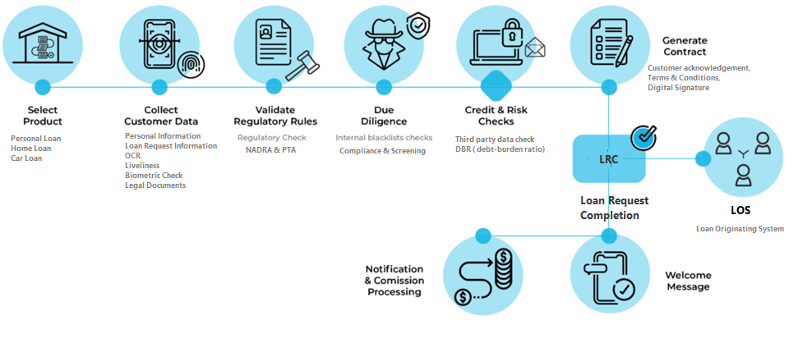
Digital Customer Onboarding (Workflow)

Slide 15
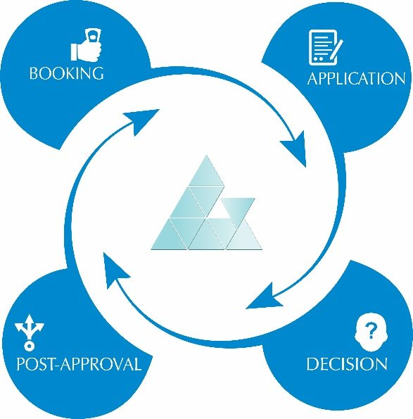
AutoLOS – Loan Origination System
Consumer Loan Origination System:
“AutoLOS Consumer is a pre-disbursement automated Consumer Loan Origination System, which covers the end-to-end workflow for consumer loans starting from origination stage till its approval. Risk analysts and Relationship Managers analyze the Consumer Application and accord approval or reject the same based on logical reasons and forwards it to the ultimate and competent approval authority, as per the bank’s policies and procedures, to accord a final approval or rejection with documented reasons.
  Customer Profiling / Assessment
    CRM details
    ECIB / Data Check
    Credit Scoring (Integrated Module AutoRISK)
  Verifications
    Internal Verification
    External Verification
    Tele , Bio Metric, Income, Address
    Compliance (Integrated Module)
  Income Estimation
  DBR
  ECIB / Data Check
  Configurable Rule Engine
    Credit Policy rules
    Segment Rules
  Organization Hierarchy Setup
    Sales Regions
    CIUs
  Credit Application / Credit Initiation
  Configurable Workflows / Deviations / Committees
  Electronic Document Management System (EDCM)
  Dashboards
  N-level Approval Hierarchies

Slide 16
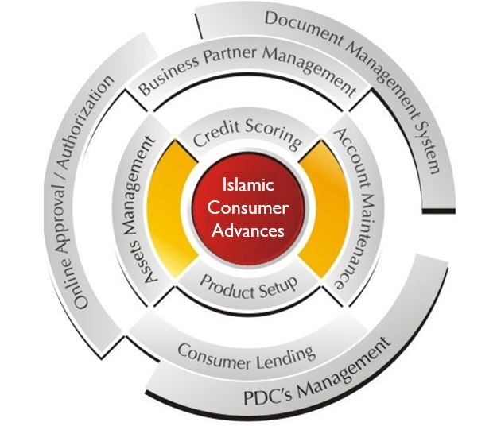
Islamic Consumer Advances
Islamic Consumer Advances AutoIBANKER Consumer advances provides an end-to-end solution, built on proven, configurable processes, for the management of the entire consumer credit lifecycle. The system provides clients with management and maintenance facilities for leasing and financing products throughout their life cycles. The systems dynamic and customizable parameter setup is used to cater to constantly evolving market requirements.
  Credit Application
  Credit Verification
  Approvals
  Customer Assessment & Scoring
  Asset Management
  Limit Management
  Purchase Order
  Disbursements
  Tracker Management
  Insurance Management
  Re-pricing / Restructuring
  NPL, provisioning & write-off
  Write Off Recovery
  EDCM (Electronic Document Management System)
  Stationery Printing
    (PO, Credit application, installment reminders, dunning letters)
  Facility Types:
    Murabaha
    Ijarah
    Tawaruk
    Qard-e-Hasna
    Diminishing Musharika
    Running Musharika
    Salam / Istisna
  Recovery Module
    Installment / Rental Recovery
    Partial payments
    Reversals
    Balloon payments
    Early Termination
    Overdue Charges

Slide 17

AutoRISK
Credit Risk Rating and Scoring System:
“AutoRISK” provides financial institutions with customer-specific (corporate, SME, consumer) and industry-specific (Textile, construction, cement etc.) models to help them assess the creditworthiness of their customer base.
  Risk Rating Model
    Corporate Risk Rating Model
    Consumer Credit Scoring Model
    Agriculture Financing Scoring Model
    SME Credit Scoring Model
  Industry wise Quartiles
  Analyze Risk Profile
  Obligor Risk Rating
    Internal Rating
    Mapping of Internal Ratings with Regulatory Ratings
  Complete Audit Trail
  Facility Risk Rating
  Capital Adequacy Ratio (CAR - Standardized approach)
  Operational Risk (Standardized approach with basic KRI's)
AutoRISK
Credit Scoring System

Slide 18
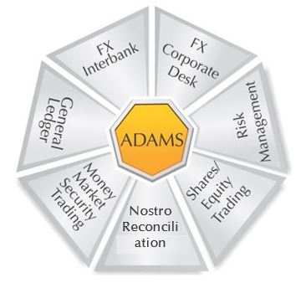
ADAMS – Islamic Treasury Management System
ADAMS – Islamic Treasury Management A fully Shariah compliant system designed to maximize productivity on your treasury’s trading desk as well as back office operations. The system provides users with real time exposure monitoring, real time pricing, cash flows in different currencies, gap analysis both in foreign as well as in local currency, securities and shares management, monitoring of different types of limits and risk analysis. The system is fully integrated with our Swift messaging system, AutoSWIFT for automatic generation of relevant SWIFT messages.
  General Ledger (Integration)
  Foreign Exchange Interbank
    Currency Spot
    Currency Promise
  Middle Office (Risk Management)
  Back Office
  Shares/ Equity/ Security Trading
  Nostro Reconciliation
  Money Market & Security Trading
    Murabaha and Reverse Murabaha
    Mudaraba
    Wakala and reverse Wakala
    Sukuk
    Ijara
  Central Bank and Regulatory Reporting

Slide 19
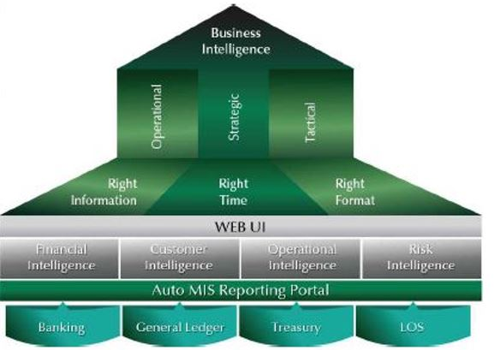
AutoMIS – Management Reporting
AutoMIS – Management Reporting A comprehensive reporting tool which forms the backbone for all of our complementing systems reporting. The system is used to generate management, central bank and other statutory reporting requirements in addition to the customized reports for internal purposes. The system facilitates financial analysts and information workers with a high level of flexibility through its parameterization so that they need not depend upon a programmer to define individual reports.
  Extract, Transform and Load (ETL)
  Report Configuration
  Data processing and analysis
  Report Generation (Report Builder)
  Reporting Portal
  Ad-hoc reporting
  Data Export (Excel, PDF, CSV) & sharing
  Scheduled Reporting
  User Role Management
  Drill-Down / Drill-Through Reporting

Slide 20
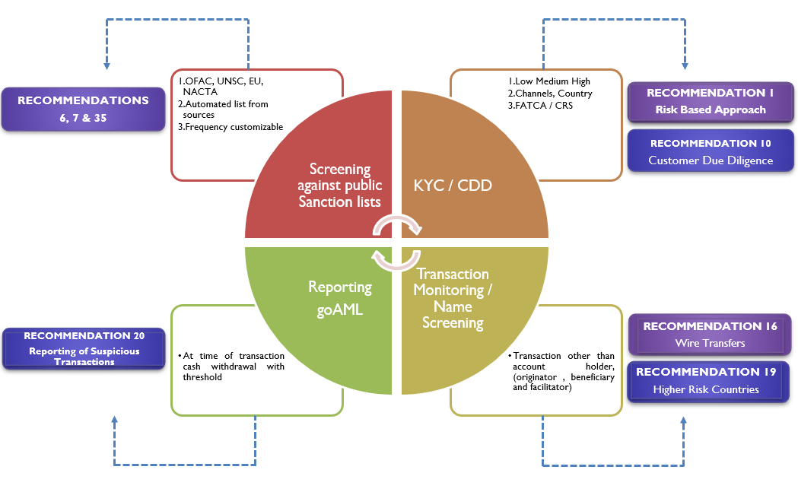
AutoCOMPLIANCE
AutoCOMPLIANCE – Financial Monitoring & Compliance Services. Financial Monitoring & Compliance Services System deals with central data processing, suspicious behavior identification engine that provides a robust, effective and easy-to-use transaction monitoring solution that is configurable and flexible to adapt new risks and regulations.
Transaction Monitoring
Transaction Alerts generation with configurable frequency
Configurable roles, seniors and workflows
Alerts Investigations, action with audit trail
Remarks with evidence document attachment
Name Screening Name Screening Alerts generation
Configurable acceptance matching score and workflows
OFAC (SDN AND NON-SDN List)
EU, UN, Local list (4th Schedule)
action with remarks and audit trail
Bulk/Portfolio Screening:
Bulk/Portfolio Name Screening Alerts generation
Configurable acceptance matching score and workflows
action with remands and audit trail
Bulk/Portfolio Name Screening against specific sanction list
Watch / Sanction List Management
Configurable schedule of downloading/updating public sanction lists
Provision of private or local watch lists
Dashboard & Reports

Slide 21











Compliance and Integrations
Credit
Report
Data
Check
Scoring
Engine
Core
Banking
Compliance
eCIB
Fraud
Management
Call
Centre
NADRA
Mobile
App
OCTR

Slide 22
TECHNOLOGIES & EMERGING ECOSYSTEM
Innovation & Inclusion in Digital Era

Slide 23
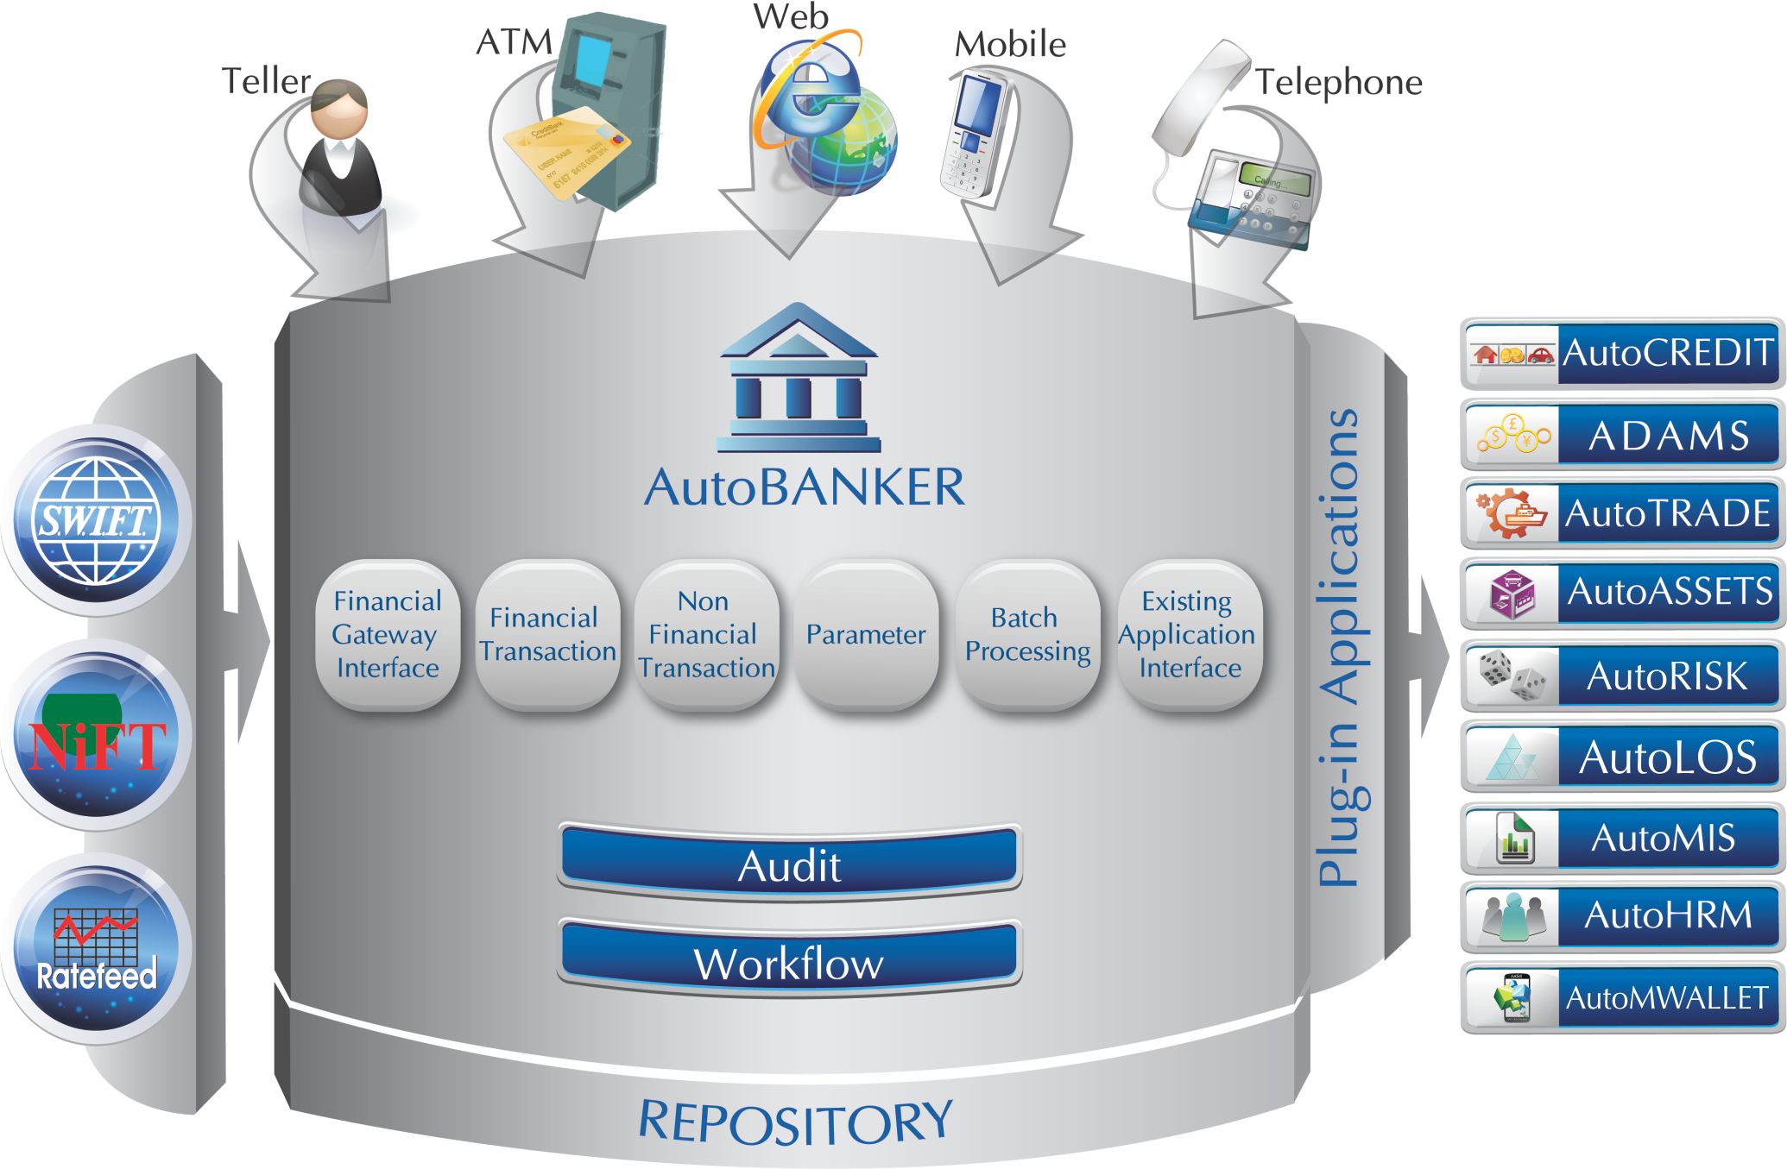
Modular Application Architecture

Slide 24












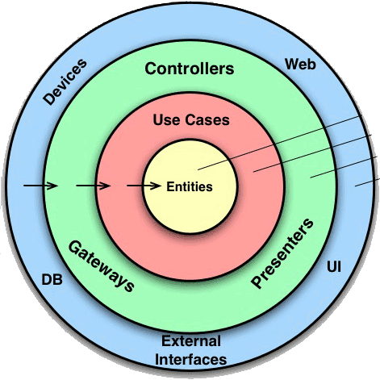






AutoBANKER Microservices Architecture
Authentication Server (JWT)
Services
Admin
Redis Cache
Service Discovery
Customer
Notification
Account
Web Server
API Gateway
User
Session Cache
In-memory Cache
Serilog
Text/Json
SQL Server
24

Slide 25
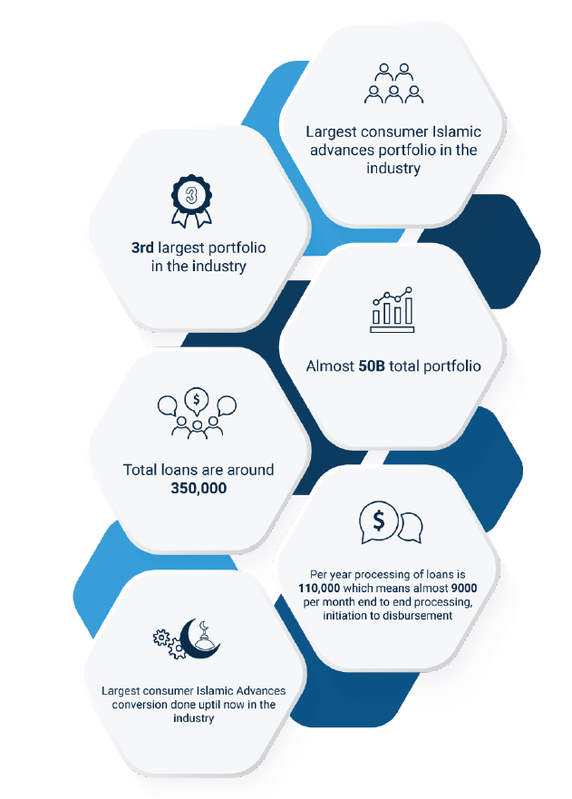
CASE STUDY – FAYSAL BANK – ISLAMIC LOAN CONVERSION
Implementation of end-to-end lending platform of Faysal Bank to streamline loan lifecycle from initiation to approval, disbursement, and recoveries
Program Scope:
  End-to-End Workflow Automation (Origination, Services, Recoveries)
  3rd Party Integrations (CBs, Verification, Compliance, Fraud, AML / CTF)
  Dual Conventional & Islamic lending via unified & future ready platform
  Decommissioning of Legacy Systems – (Systems, Automation, Digitalization, Customer Experience)
Success & Benefits realized by Faysal Bank
  Largest consumer lending portfolio conversions to Islamic in the Industry

Slide 26
Emerging Technologies – Value Creation
CBDC
AI
Digital
Blockchains & emerging DLT ecosystem of wholesale and retail digital currency
Applications in RPA, Channel Banking, Operational efficacy & Smart Flags in Data Driven Decisioning
Low Code / No Code – Cross Platform Apps (ready to deploy) for CX | DX

Slide 27
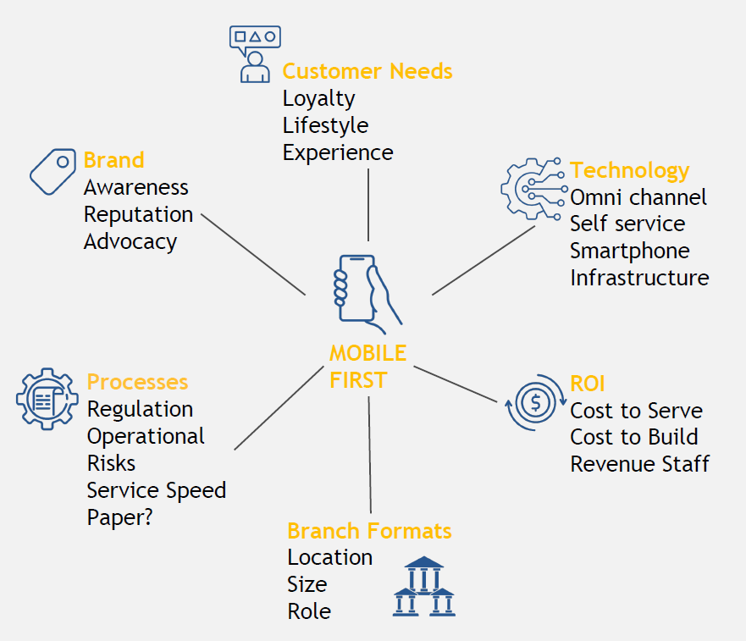
CX | DX – Cross Platform Apps (LC/NC)
Investment Thesis
  Hybrid Banking – Consumer interaction approach has changed
  Engagements – Interactive approach with customers for relevance
  Evolving – From functional to experiential
  Evolving – Branch banking role in the full eco system
Functional Transactional Touch Points
Towards
Experiential / Inspirational Touch Points
Relationships
Inspiring
Transactions
Functional

Slide 28
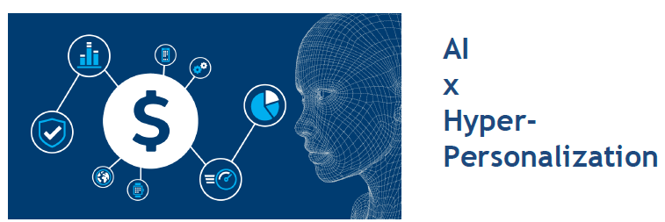
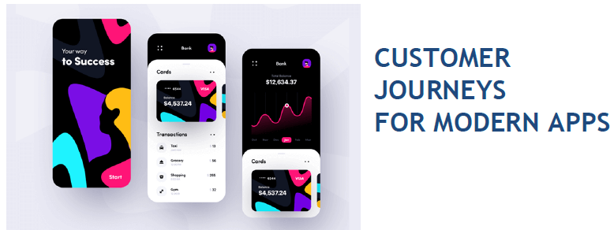
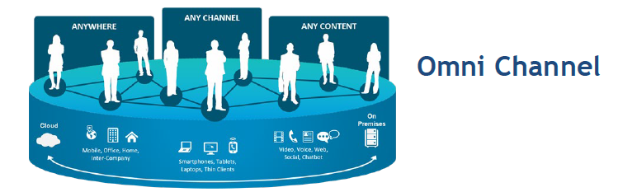
CX | DX – AI + Experience + OmniChannel
Key Areas of Investment
Experiential – Customer Journeys for Interactive & Cross Platform Apps
Engagements – Omni Channel (Any Channel, Any Content, Anywhere)
Decisioning – AI for Hyper - Personalization

Slide 29
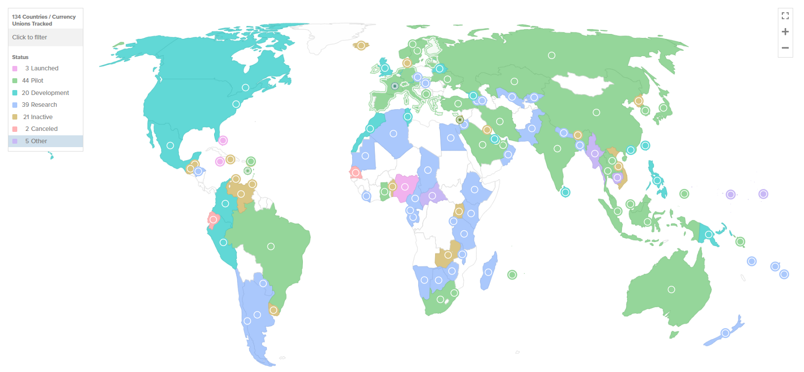
CBDC & Synthetic Stable Coins – Global State of Play

Slide 30
CBDC & Synthetic Stable Coins – Global State of Play
134 countries & currency unions, representing 98% of global GDP, are exploring a CBDC.
There is a new high of 44 ongoing CBDC pilots, including the digital euro.
US is now participating in a cross-border wholesale CBDC (Project Agora), with 6 other major central banks.
G20 countries exploring CBDC, with 19 in advanced stages of pilot i.e. Brazil, Japan, India, Australia, Russia, Turkey China, Russia, South Africa.
13 projects – including pilot mBridge – which connects banks in China, Thailand, the UAE, Hong Kong, and Saudi Arabia.
3 countries have fully launched a retail CBDC – the Bahamas, Jamaica and Nigeria.
All advanced retail CBDC projects are intermediated, i.e., distributed through Banks, FIs, and PSPs.
Digital yuan (e-CNY) is the largest CBDC pilot in the world. In June 2024, total transaction volume reached 7 trillion e-CNY ($986 billion) in 17 provincial regions across sectors such as education, healthcare, and tourism. This is 4x the 1.8 trillion yuan ($253 billion) since June 2023.

Slide 31
CBDC – Use Cases under R&D (Retail, Wholesale, Assets, GRC)
Sr. No. | Use Case | Type | App | Notes
1 | Domestic Payment | Token / Account | Retail | CBDCs offer a digital alternative to physical cash, enabling individuals and business to make everyday transactions within a country electronically, enhancing convenience and efficiency while reducing reliance on traditional banking infrastructure
2 | Cross-Border Payments | Tokens | Wholesale | CBDCs streamline cross-border transactions by facilitating faster, cheaper, and more transparent transfers compared to traditional methods, bypassing intermediaries and reducing settlement times, which benefits businesses, individuals, and economies alike.
3 | Remittances | Token / Account | Wholesale (Bridge) | CBDCs provide expatriates with a cost-effective and efficient means to send money to their families back home, reducing fees and processing times associated with traditional remittance channels, thereby improving the livelihoods of recipients and fostering financial inclusion
4 | Financial Inclusion | Token / Account | Retail | CBDCs bridge the gap between the unbanked or underbanked populations and formal financial services by offering a secure and accessible digital payment solution, empowering individuals to participate in the formal economy and improve their financial well-being.
5 | Government Benefits and Subsidies | Account | Retail | CBDCs enable governments to distribute social welfare benefits and subsidies directly to citizens’ digital wallets, enhancing transparency, reducing administrative costs, and minimizing leakage and fraud in social welfare programs.
6 | E-Commerce | Token | Retail | CBDC’s facilitate seamless online payments for goods and services, providing merchants and consumers with a secure, low-cost, and efficient payment method, thereby stimulating e-commerce growth and fostering digital economic activity
7 | Micropayments | Token | Retail | CBDCs support cost-effective transactions for small-value purchases, such as digital content, online services, or microtransactions in gaming, enabling new business models and revenue streams while enhancing user experience and convenience
8 | Tokenization of Assets | Token | Assets | CBDCs enable the tokenization of various assets, including real estate, stocks and commodities, by representing them as digital tokens on a blockchain, thereby increasing liquidity, accessibility and efficiency in asset markets
9 | Smart Contracts and Programmable Money | Token | Retail | CBDCs facilitate the execution of smart contracts, enabling automated and trustless contractual agreements with predefined conditions, i.e., automated payments upon the fulfillment of contractual obligations, enhancing efficiency and reducing counterparty risk
10 | Supply Chain Finance | Token | Retail | CBDCs streamline trade finance processes by digitizing trade documents, automating payment settlements, and providing transparent and immutable transaction records along the supply chain, thereby reducing costs, delays, and fraud in global trade

Slide 32
CBDC – Use Cases under R&D (Retail, Wholesale, Assets, GRC)
Sr. No. | Use Case | Type | App | Notes
11 | Identity Verification | Token | GRC | CBDCs service as a foundation for secure digital identity systems, enabling individuals to prove their identity electronically while enhancing privacy, security, and efficiency in identity verification processes, thereby reducing fraud and improving access to financial services
12 | International Trade Settlement | Account / Token | Wholesale | CBDCs simplify and accelerate the settlement of international trade transactions by serving as a common settlement currency, reducing reliance on multiple currencies, intermediaries, and settlement delays, thereby lowering transaction costs and enhancing trade efficiency.
13 | Monetary Policy Transmission | Token | GRC | CBDCs provide central banks with real-time visibility into money flows and economic activity, enabling more effective implementation and transmission of monetary policy tools, i.e., interest rate adjustments, reserve requirements, and quantitative easing measures, to achieve economic objectives.
14 | Peer-to-Peer Lending | Account / Token | Retail | CBDCs facilitate peer-to-peer lending platforms, allowing individuals to lend and borrow funds directly from each other without intermediaries, thereby providing access to credit for underserved populations and enabling efficient capital allocation.
15 | Charitable Donations | Account / Token | Retail | CBDCs increase transparency and traceability in charitable donations by providing donors and recipients with immutable transaction records on a blockchain, ensuring that funds are allocated efficiently, fraud is minimized, and trust in charitable organizations is enhanced.
16 | Crowdfunding | Account / Token | Retail | CBDCs enable crowdfunding campaigns to raise funds for projects or initiatives by issuing digital tokens representing contributors' stakes in the project, thereby democratizing access to capital, fostering innovation, and enabling community-driven projects.
17 | Gambling and Gaming | Token | Retail | CBDCs provide a secure and transparent payment method for online gambling and gaming platforms, enhancing user trust, fairness, and compliance with regulatory requirements, while reducing transaction costs and fraud associated with traditional payment methods.
18 | Healthcare | Token | Assets | CBDCs facilitate the exchange of medical records and payments between healthcare providers and patients securely and efficiently, enabling seamless access to healthcare services, improving patient outcomes, and reducing administrative burdens and costs.
19 | Carbon Credits Trading | Token | Assets | CBDCs create a transparent marketplace for buying and selling carbon credits, enabling businesses and individuals to trade carbon credits efficiently, incentivizing emissions reductions, and promoting sustainable development and environmental conservation efforts.
20 | Public Transportation | Token | Retail | CBDCs integrate with public transportation systems, allowing passengers to pay for fares seamlessly using digital wallets or mobile apps, thereby improving the efficiency, accessibility, and affordability of public transportation services while reducing reliance on cash and physical tickets.

Slide 33
CBDC – Digital Rupee Pilot Roadmap (iRupee - Sandbox)
Phase 1: 2025 Research & Exploration | Phase 2: 2026 Design | Phase 3: 2027 Build | Phase 4: 2027 – 2030 Deploy / Live Use Case 1, 2, 3….) | Phase 5: 2030 – 2035 New Stream(s) of Use Cases, i.e., wholesale, bridges, etc.
Initial exploration | Technical development work and proof of concepts based on the proposed model | Developing prototypes | 2027 – Deploying / roll out of initial use case(s) “x” on developed platform | 2030 – Considering and deploying additional use case(s) – as per maturity & utility
Economic, functional and technology analysis | Developing architecture and the digital rupee platform technical design | Live pilot tests | 2028 - 2029 – Perfecting use case(s) “x” and deploying / roll out of use case(s) “y” on enhanced platform | 2031 – Considering and deploying additional use case(s) – as per maturity & utility
Consultation paper and Technology Working Paper |  |  | 2029 – 2030 – Perfecting use case(s) “y” and deploying / roll out of use case(s) “z” on mature platform | 2031 – Considering and deploying additional use case(s) – as per maturity & utility
Budget USD…. | Budget USD…. | Budget USD… | Budget USD….

Slide 34
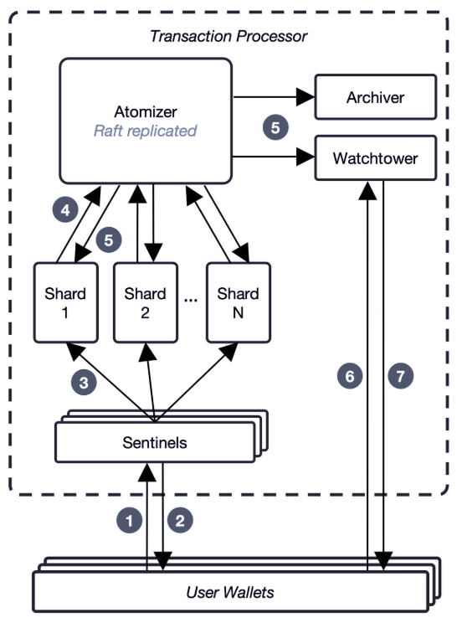
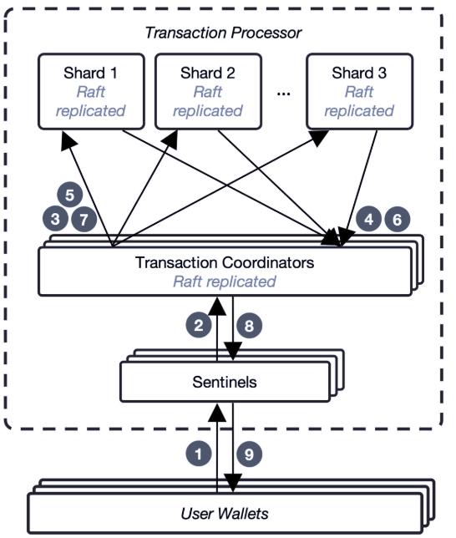
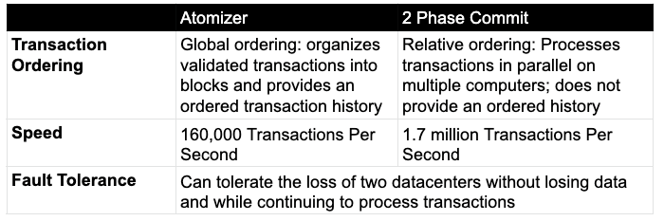
CBDC – Architecture – MIT’s Atomizer

Slide 35

Thank you !

Slide 36
TECHNOLOGIES & EMERGING ECOSYSTEM
Innovation, Inclusion & Shariah Compliance in Digital Era

